Slide 1
CMOS Active Filters
Gábor C. Temes
School of Electrical Engineering and
Computer Science
Oregon State University
Rev. April 2014

Slide 2
Filtering
Task of filters: suppress unwanted signals, change the behavior (amplitude and/or phase) of the wanted ones.
Analog filters: process physical signals, limited accuracy, stability and resolution. Simple structure.
Digital filters: processes numbers only. Highly accurate, stable, extremely high resolution and accuracy possible. Complex structure. Need data conversion to interface with the physical world.

Slide 3
Filtering Examples
Audio transceiver:
From F. Maloberti and G.C. Temes, CMOS Analog Filter Design, Wiley, 2015.
Ultrasonic imager
Task: Transmit section: antialiasing; receive section; suppression of unwanted signals with large dynamic range. Linear phase, low power.

Slide 4
Structure of the Lectures
Only CMOS integratable filters are discussed;
Continuous-time CMOS filters;
Discrete-time switched-capacitor filters (SCFs);
Non-ideal effects in SCFs;
Design examples: a Gm-C filter and an SCF;
The switched-R/MOSFET-C filter.

Slide 5
Classification of Filters
Digital filter: both time and amplitude are quantized.
Analog filter: time may be continuous (CT) or discrete (DT); the amplitude is always continuous (CA).
Examples of CT/CA filters: active-RC filter, Gm-C filter.
Examples of DT/CA filters: switched-capacitor filter (SCF), switched-current filter (SIF).
Digital filters need complex circuitry, data converters.
CT analog filters are fast, not very linear and inherently inaccurate, may need tuning circuit for controlled response.
DT/CA filters are linear, accurate, slower.

Slide 6
Filter Design
Steps in design:
1. Approximation – translates the specifications into
a realizable rational function of s (for CT filters) or
z (for DT filters). May use MATLAB, etc. to obtain
Chebyshev, Bessel, etc. response.
2. System-level (high-level) implementation – may
use Simulink, etc. Architectural and circuit design
should include scaling for impedance level and
signal swing.
3. Transistor-level implementation – may use CAD
tools (SPICE, Spectre, etc).
These lectures will focus on Step. 2 for CMOS filters.

Slide 7
Mixed-Mode Electronic Systems
Analog filters are needed to suppress out-of-band noise and prevent aliasing. Also used as channel filters, or as loop filters in PLLs and oversampled ADCs, etc.
In a mixed-mode system, continuous-time filter allows sampling by discrete-time switched-capacitor filter (SCF). The SCF performs sharper filtering; following DSP filtering may be even sharper.
In Sit.1, SCF works as a DT filter; in Sit.2 it is a CT one.

Slide 8
Frequency Range of Analog Filters
Discrete active-RC filters: 1 Hz – 100 MHz
On-chip continuous-time active filters: 10 Hz - 1 GHz
Switched-capacitor or switched-current filters:
1 Hz – 10 MHz
Discrete LC: 10 Hz - 1 GHz
Distributed: 100 MHz – 100 GHz

Slide 9
Accuracy Considerations
The absolute accuracy of on-chip analog components is poor (10% - 50%). The matching accuracy of like elements can be much better with careful layout.
In untuned analog integrated circuits, on-chip Rs can be matched to each other typically within a few %, Cs within 0.05%, with careful layout. The transconductance (Gm) of stages can be matched to about 10 - 30%.
In an active-RC filter, the time constant Tc is determined by RC products, hence it is accurate to only 20 – 50%. In a Gm-C filter , Tc ~ C/Gm, also inaccurate. Tuning may be used to obtain 1 - 5% accuracy.
In an SC filter, Tc ~ (C1/C2)/fc, where fc is the clock frequency. Tc accuracy may be 0.05% or better!

Slide 10
Design Strategies
Three basic approaches to analog filter design:
1. For simple filters (e.g., anti-aliasing or smoothing
filters), a single-opamp stage may be used.
2. For more demanding tasks, cascade design is
often used– splits the transfer function H(s)
or H(z) into first and second-order realizable
factors, realizes each by buffered filter sections
connected in cascade. Simple design and
implementation, medium sensitivity and noise.
3. Multi-feedback (simulated reactance filter)
design. Complex design and structure, lower
noise and sensitivity. Hard to lay out and debug.

Slide 11
Active-RC Filters [1], [4], [5]
Single-amplifier filters: Sallen-Key filter; Kerwin filter; Rauch filter, Delyiannis-Friend filter. Simple structures, but with high sensitivity for high-Q response.
Integrator-based filter sections: Tow-Thomas biquads; Ackerberg-Mossberg filter. 2 or 3 op-amps, lower sensitivity for high-Q. May be cascaded.
Cascade design issues: pole-zero pairing, section ordering, dynamic range optimization. OK passband sensitivities, good stopband rejection.
Simulated LC filters: gyrator-based and integrator-based filters; dynamic range optimization. Low passband sensitivities and noise, but high stopband sensitivity and complexity in design, layout, testing.

Slide 12
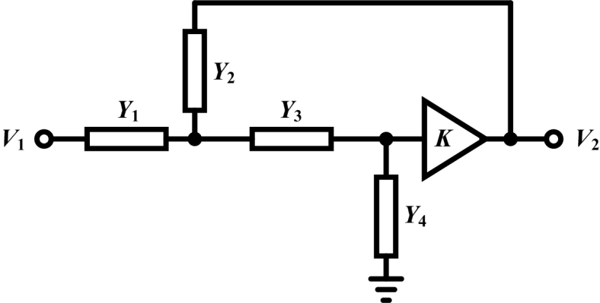
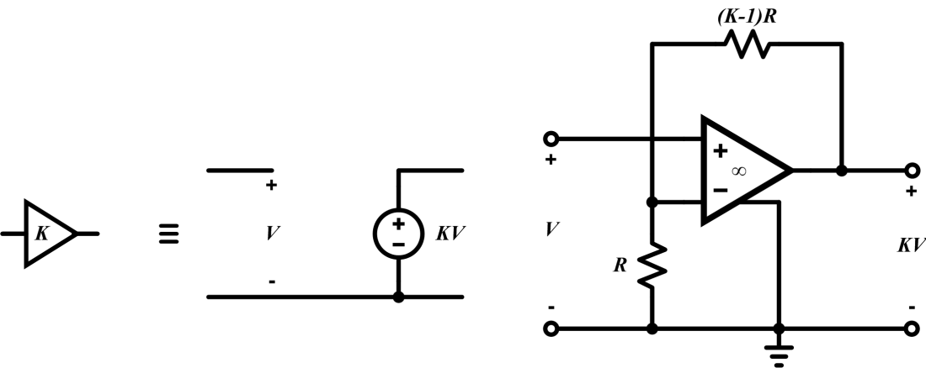
Sallen-Key Filter [1],[4]
First single-opamp biquad. General diagram:
Often, K = 1. Has 5
parameters, only 3
specified values.
Scaling or noise
reduction possible.
Realization of
active block:
Amplifier not grounded. Its input common-mode changes with output. Differential implementation difficult.

Slide 13
Sallen-Key Filter
Transfer function:
Second-order transfer function (biquad) if two of the admittances are capacitive. Complex poles are achieved by subtraction of term containing K.
3 specified parameters (1 numerator coefficient, 2 denominator coeffs for single-element branches).

Slide 14
Sallen-Key Filter
Low-pass S-K filter (R1, C2, R3, C4):
Highpass S-K filter (C1, R2, C3, R4):
Bandpass S-K filter ( R1, C2, C3, R4 or C1, R2, R3, C4):

Slide 15
Sallen-Key Filter
Pole frequency ωo: absolute value of natural mode;
Pole Q: ωo/2|real part of pole|. Determines the stability, sensitivity, and noise gain. Q > 5 is dangerous, Q > 10 can be lethal! For S-K filter,
dQ/Q ~ (3Q –1) dK/K .So, if Q = 10, 1% error in K results in 30% error in Q.
Pole Q tends to be high in band-pass filters, so S-K may not be suitable for those.
Usually, only the peak gain, the Q and the pole frequency ωo are specified. There are 2 extra degrees of freedom. May be used for specified R noise, minimum total C, equal capacitors, or K = 1.
Use a differential difference amplifier for differential circuitry.

Slide 16
Kerwin Filter
Sallen-Key filters cannot realize finite imaginary zeros, needed for elliptic or inverse Chebyshev response. Kerwin filter can, with Y = G or sC. For
Y = G, highpass response; for Y = sC, lowpass.

Slide 17
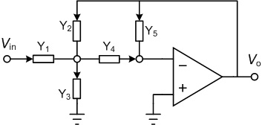
Single-Amplifier Stage
General single-opamp stage, with grounded opamp, suitable for differential implementation:

Slide 18
Single-Amplifier Stage
Transfer function H(s):
For Y1 = G1 and Y4 = G4, Rauch (low-pass) filter; for Y1 = G1 and Y4 = sC4, Delyiannis (bandpass) filter. For Y1 = sC1, Y2 = sC2 and Y4 = sC4, high-pass filter results.

Slide 19
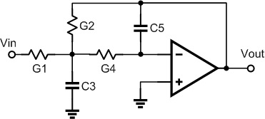
Rauch Filter
Often applied as anti-aliasing low-pass filter:
Grounded opamp, may be realized fully differentially. 5 parameters, 3 constraints. Minimum noise, or C1 = C2, or minimum total C can be achieved.
Size of resistors limited by thermal (4kTR) noise. Smaller resistors, larger capacitors -> less noise, more power!

Slide 20
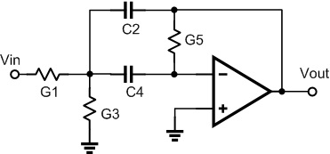
Delyiannis-Friend Filter
Single-opamp bandpass filter:
Grounded opamp, Vcm = 0. The circuit may be realized in a fully differential form suitable for noise cancellation. Input CM is held at analog ground.
Finite gain slightly reduces gain factor and Q. Sensitivity is not too high even for high Q.

Slide 21
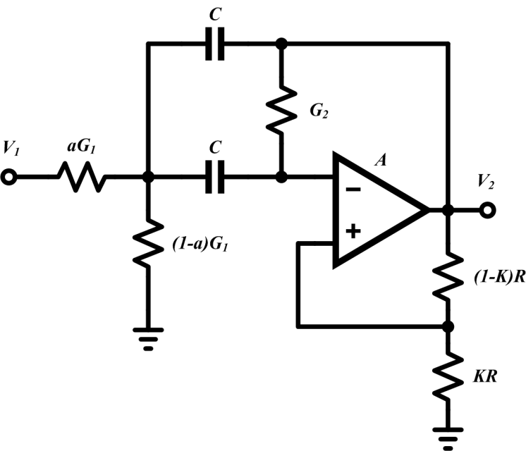
Delyiannis-Friend Filter
Q may be enhanced using positive feedback:
New Q =
α = K/(1-K)
Opamp no longer grounded, Vcm not zero, no easy fully differential realization.

Slide 22
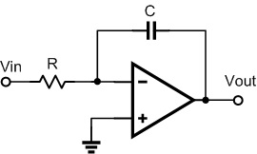
Active-RC Integrator
Transfer functions:
Circuit:

Slide 23
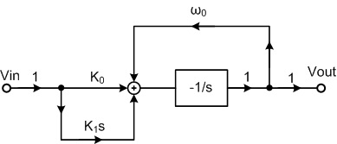
Bilinear Filter Stage
Transfer function:
Block diagram:

Slide 24
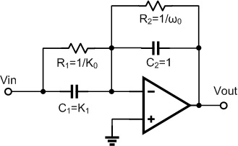
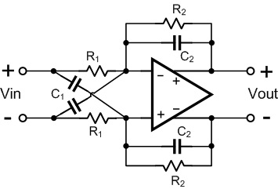
Bilinear Filter Stage
Circuit diagram:
For positive zero:

Slide 25
Biquadratic Filter Stages (Biquads)
Biquadratic transfer function:
An important parameter in filter design is the pole-Q. It is defined as Q = ω₀/(2|σ_{p}|), where ω₀ is the magnitude of the complex pole, often called pole frequency, and σ_{p} is the real part (σ_{p} < 0) of the pole.

Slide 26
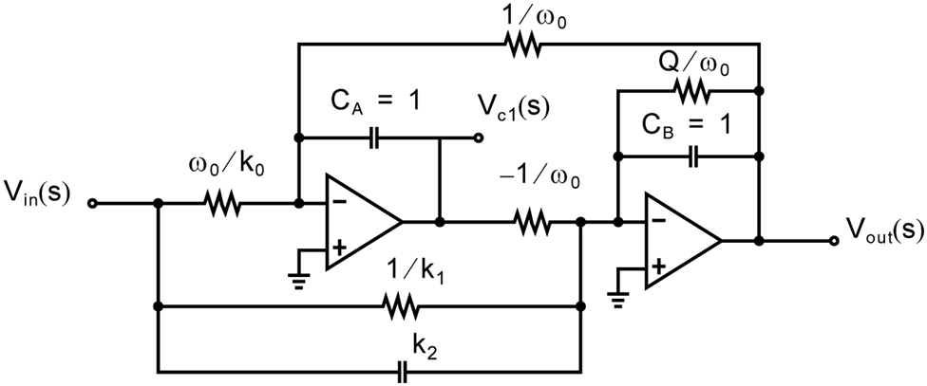
Low-Q Tow-Thomas Biquad
Multi-opamp integrator-based biquads: lower sensitivities, better stability, and more versatile use. They can be realized in fully differential form.
The Tow-Thomas biquad is a sine-wave oscillator, stabilized by one or more additional element. (Here by the resistor Q/ω₀.) This reduces the integrator phase shift to a value below 90º .

Slide 27
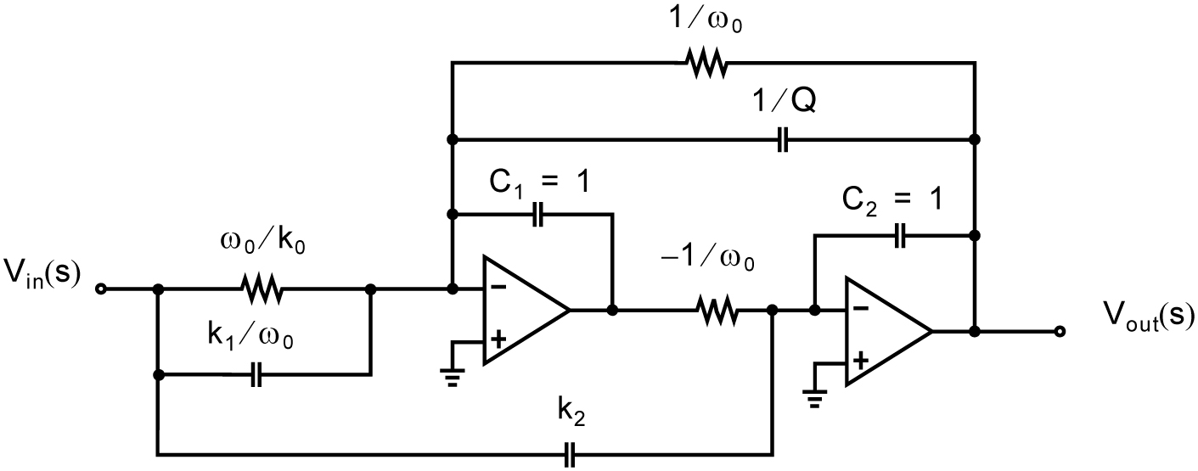
High-Q Tow-Thomas Biquad
For high-Q poles, damping can be introduced by shunting the feedback resistor with a capacitor. In the low-Q biquad, the value of Q is determined by the ratio of the damping resistor to the other integrator resistors, while in the biquad shown by the ratio of the damping capacitance to the feedback ones. Since large capacitance ratios are more accurately controlled than large resistance ratios, this circuit is preferable for the realization of high-Q biquads.

Slide 28
Biquad Design Issues
The Tow-Thomas biquads contain 8 designeable elements.
The prescribed transfer function has 5 coefficients, so there are 3 degrees of freedom available.
One degree should be used for dynamic range scaling of the first opamp, the other two to optimze the impedance level of both stages
.
Higher impedance level yields lower power requirements, lower level gives lower noise.

Slide 29
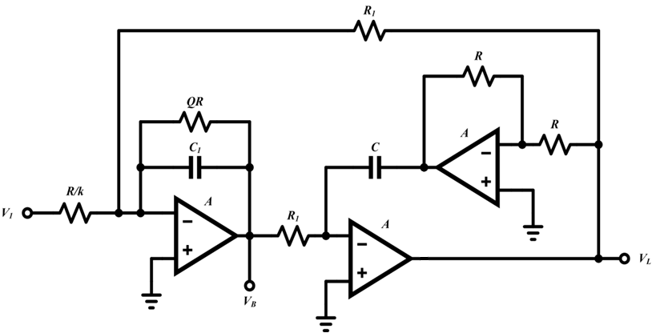
Ackerberg–Mossberg Filter [1]
Similar to the Tow-Thomas biquad, but less sensitive to finite opamp gain effects.
The inverter is not needed for fully differential realization. Then it becomes the Tow-Thomas structure.

Slide 30
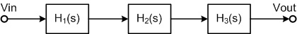
Cascade Filter Design [3], [5]
Higher-order filter can constructed by cascading low-order ones. The Hi(s) are multiplied, provided the stage outputs are buffered.
The Hi(s) can be obtained from the overall H(s) by factoring the numerator and denominator, and assigning conjugate zeros and poles to each biquad.
Sharp peaks and dips in |H(f)| cause noise spurs in the output. So, dominant poles should be paired with the nearest zeros.

Slide 31
Cascade Filter Design [5]
Ordering of sections in a cascade filter dictated by low noise and overload avoidance. Some rules of thumb:
High-Q sections should be in the middle;
First sections should be low-pass or band-pass, to suppress incoming high-frequency noise;
All-pass sections should be near the input;
Last stages should be high-pass or band-pass to avoid output dc offset.

Slide 32
Rules of Cascade Filter Design [5]
1. Order the stages in the cascade so as to equalize their output signal swings as much as possible for dynamic range considerations;
2. Choose the first biquad to be a lowpass or bandpass to reject high-frequency noise, and thus to prevent overload in the remaining stages;
3. lf the reduction of the DC offset at the filter output is critical, the last stage should be a highpass or bandpass section, to reject the DC offset introduced by the preceding stages;
4. The last stage should NOT in general have a high Q, because these stages tend to have higher fundamental noise and worse sensitivity to power supply noise;

Slide 33
More Rules of Cascade Filter Design
5. Also, do not place all-pass stages at the end of the cascade, because these have wideband noise. It is usually best to place all-pass stages near the input port of the filter.
6. If several highpass or bandpass stages are available, one can place them at the beginning, middle and end of the filter. This will prevent the input offset from overloading the filter, and also will prevent the internal offsets of the filter from accumulating (and hence decreasing the available signal swing).
The amount of thermal noise at the filter output varies widely with the order of its sections; therefore by careful ordering several dB of SNR improvement can often be gained.

Slide 34
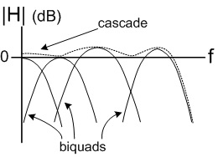
Cascade Filter Performance
Cascade filters achieve a flat passband by cancelling the slopes of the gain responses of the individual sections. This is an inaccurate process, and hence the passband ripple of these filters is not well controlled. It is difficult to achieve a ripple less than, say, 0.1 dB. By contrast, since the stopband attenuations of the sections (in dB) are simply added, very high stop-band attenuations can be realized.

Slide 35
Dynamic Range Optimization [3]
Scaling for dynamic range optimization is very important in multi-op-amp filters.
Active-RC structure:
Op-amp output swing must remain in linear range, but should be made large, as this reduces the noise gain from the stage output to the filter output. However, it reduces the feedback factor and hence increases the settling time.

Slide 36
Dynamic Range Optimization
Multiplying all impedances connected to the opamp output by k, the output voltage Vout becomes k.Vout, and all output currents remain unchanged.
Choose k.Vout so that the maximum swing occupies a large portion of the linear range of the opamp.
Find the maximum swing in the time domain by plotting the histogram of Vout for a typical input, or in the frequency domain by sweeping the frequency of an input sine-wave to the filter, and compare Vout with the maximum swing of the output opamp.

Slide 37
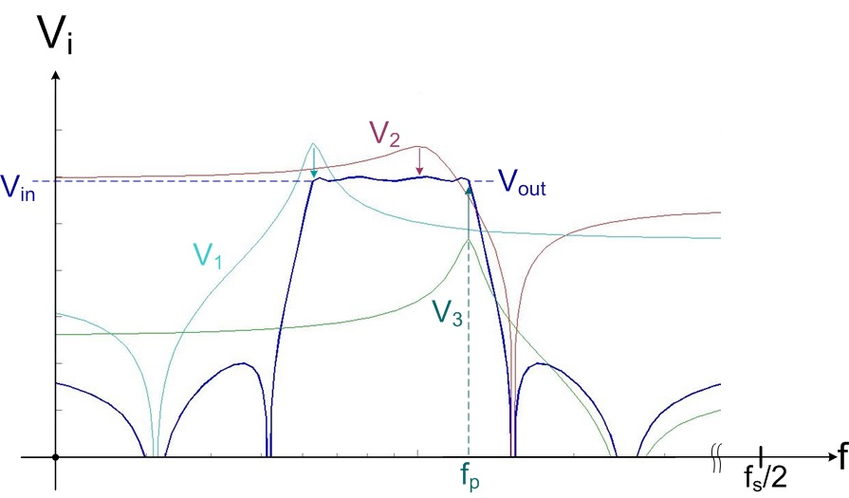
Optimization in Frequency Domain

Slide 38
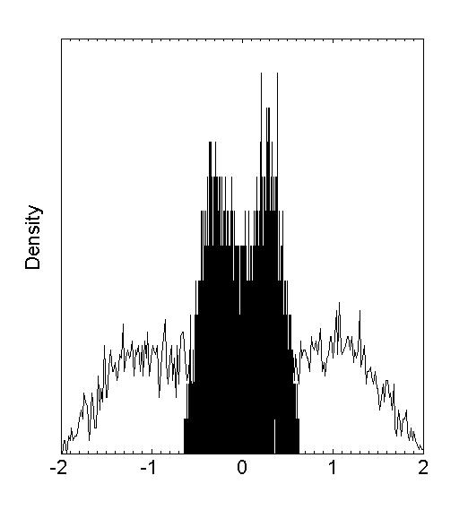
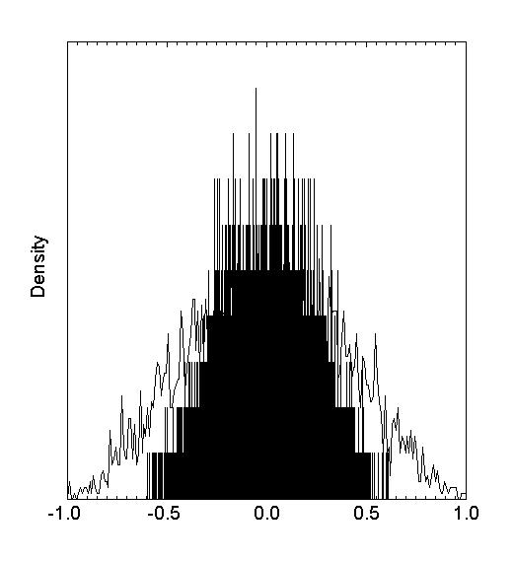
Optimization in the Time Domain
Histogram-based optimization:

Slide 39
Impedance Level Scaling
Lower impedance -> lower noise, but more bias power!
All admittances connected to the input node of the opamp may be multiplied by a convenient scale factor without changing the output voltage or output currents. This may be used, e.g., to minimize the area of capacitors.
Impedance scaling should be done after dynamic range scaling, since it doesn’t affect the dynamic range.

Slide 40
Tunable Active-RC Filters [2], [3]
Tolerances of RC time constants typically 30 ~ 50%, so the realized frequency response may not be acceptable.
Resistors may be trimmed, or made variable and then automatically tuned, to obtain time constants locked to the period T of a crystal-controlled clock signal.
Simplest: replace Rs by MOSFETs operating in their linear (triode) region. MOSFET-C filters result.
Compared to Gm-C filters, slower and need more power, but may be more linear, and easier to design.

Slide 41
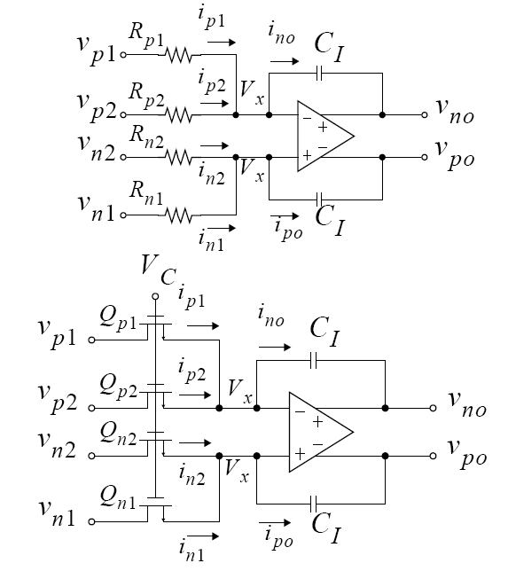
Two-Transistor Integrators
Vc is the control voltage for the MOSFET resistors.

Slide 42
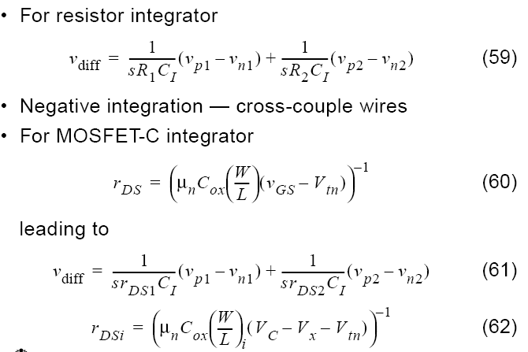
Two-Transistor Integrators

Slide 43
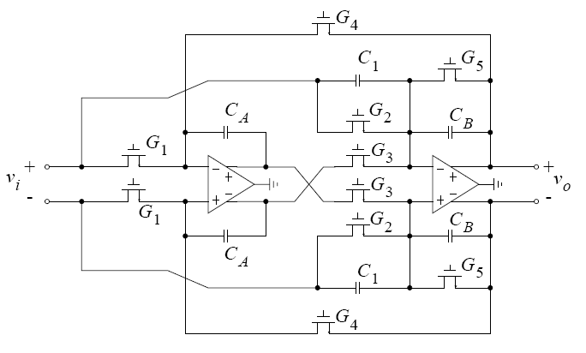
MOSFET-C Biquad Filter [2], [3]
Tow-Thomas MOSFET-C biquad:

Slide 44
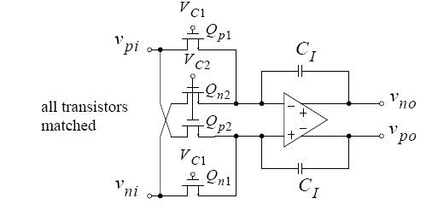
Four-Transistor Integrator
Linearity of MOSFET-C integrators can be improved by using 4 transistors rather than 2 (Z. Czarnul):
May be analyzed as a two-input integrator with inputs (Vpi-Vni) and (Vni-Vpi).

Slide 45
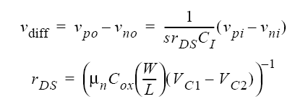
Four-Transistor Integrator
If all four transistor are matched in size,
Model for drain-source current shows nonlinear terms not dependent on controlling gate-voltage;
All even and odd distortion products will cancel;
Model only valid for older long-channel length technologies;
In practice, about a 10 dB linearity improvement.

Slide 46
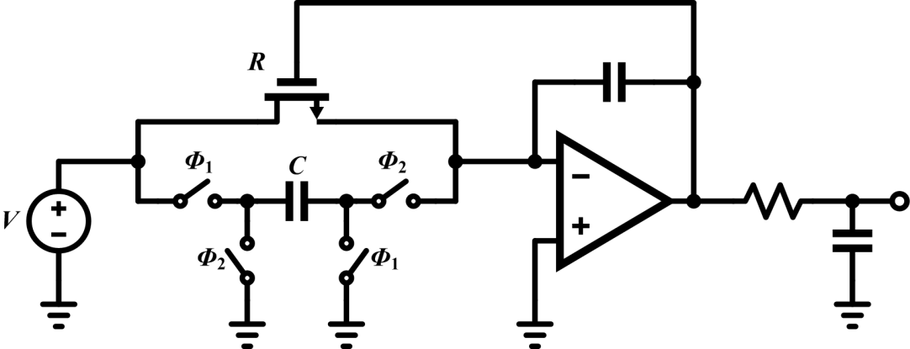
Tuning of Active-RC Filters
Rs may be automatically tuned to match to an accurate off-chip resistor, or to obtain an accurate time constant locked to the period T of a crystal-controlled clock signal:
In equilibrium, R.C = T. Match Rs and Cs to the ones in the tuning stage using careful layout. Residual error 1-2%.

Slide 47
Switched-R Filters [6]
Replace tuned resistors by a combination of two resistors and a periodically opened/closed switch.
Automatically tune the duty cycle of the switch:

Slide 48
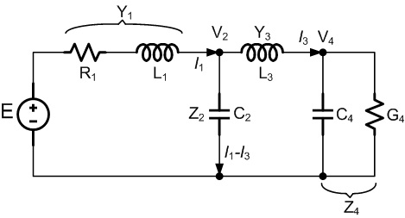
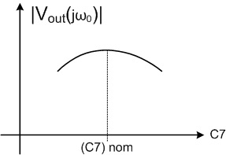
Simulated LC Filters [3], [5]
A doubly-terminated LC filter with near-optimum power transmission in its passband has low sensitivities to all L & C variations, since the output signal can only decrease if a parameter is changed from its nominal value.

Slide 49
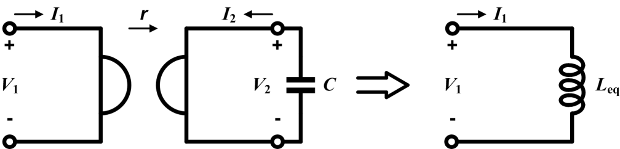
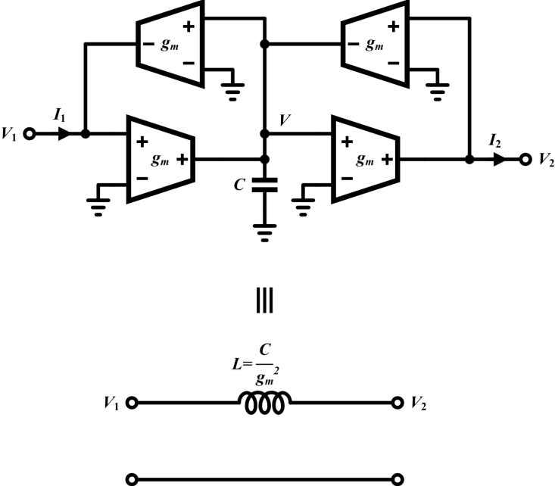
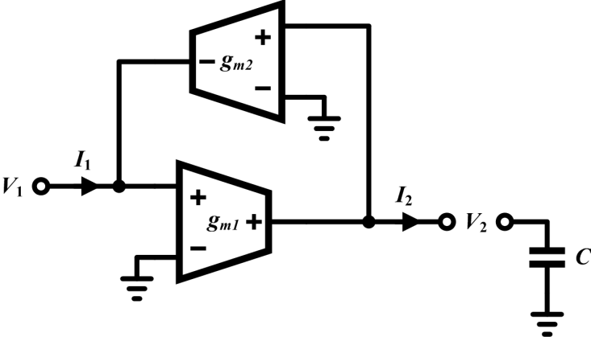
Simulated LC Filters
Simplest: replace all inductors by gyrator-C stages:
Using transconductances:

Slide 50
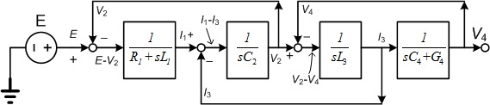
Simulated LC Filters with Integrators
Simulating the Kirchhoff and branch relations for the circuit:
Block diagram:

Slide 51
Simulated LC Filters Using Integrators

Slide 52
Cascade vs. LC Simulation Design
Cascade design: modular, easy to design, lay out, trouble-shoot. Passband sensitivities moderate (~0.3 dB),
since peaks need to be matched, but the stopband sensitivities excellent, since the stopband losses of the cascaded sections add.
LC simulation: passband sensitivities (and hence noise suppression) excellent due to Orchard’s Rule. Stopband sensitivities high, since suppression is only achieved by cancellation of large signals at the output:

Slide 53
Gm-C Filters [1], [2], [5]
Alternative realization of tunable continuous-time filters: Gm-C filters.
Faster than active-RC filters, since they use open-loop stages, and (usually) no opamps..
Lower power, since the active blocks drive only capacitive loads.
More difficult to achieve linear operation (no feedback).

Slide 54
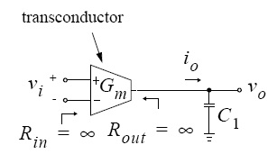
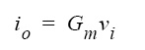
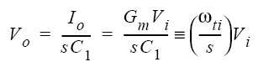
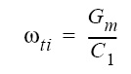
Gm-C Integrator
Uses a transconductor to realize an integrator;
The output current of Gm is (ideally) linearly related to the input voltage;
Output and input impedances are ideally infinite.
Gm is not an operational transconductance amplifier (OTA) which needs a high Gm value, but need not be very linear.

Slide 55
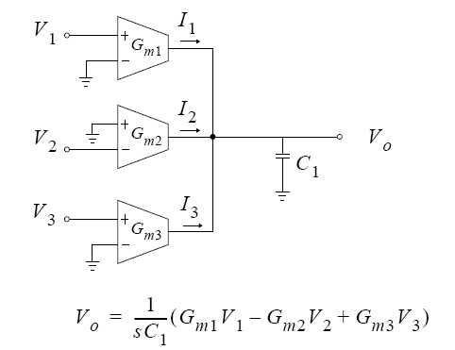
Multiple-Input Gm-C Integrator
It can process several inputs:

Slide 56
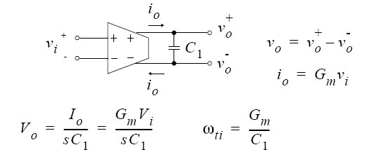
Fully-Differential Integrators
Better noise and linearity than for single-ended operation:
Uses a single capacitor between differential outputs.
Requires some sort of common-mode feedback to set output common-mode voltage.
Needs extra capacitors for compensating the common-mode feedback loop.

Slide 57
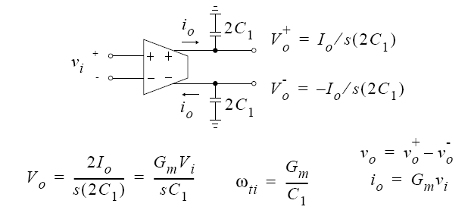
Fully-Differential Integrators
Uses two grounded capacitors; needs 4 times the capacitance of previous circuit.
Still requires common-mode feedback, but here the compensation for the common-mode feedback can utilize the same grounded capacitors as used for the signal.

Slide 58
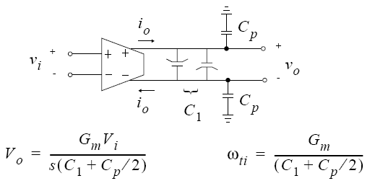
Fully-Differential Integrators
Integrated capacitors have top and bottom plate parasitic capacitances.
To maintain symmetry, usually two parallel capacitors turned around are used, as shown above.
The parasitic capacitances affect the time constant.

Slide 59
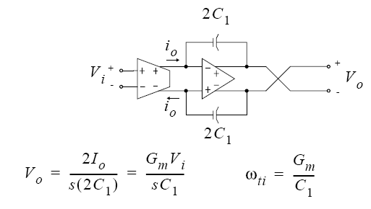
Gm-C-Opamp Integrator
Uses an extra opamp to improve linearity and noise performance.
Output is now buffered.

Slide 60
Gm-C-Opamp Integrator
Advantages
Effect of parasitics reduced by opamp gain —more accurate time constant and better linearity.
Less sensitive to noise pick-up, since transconductor output is low impedance (due to opamp feedback).
Gm cell drives virtual ground — output impedance of Gm cell can be lower, and smaller voltage swing is needed.
Disadvantages
Lower operating speed because it now relies on
feedback;
Larger power dissipation;
Larger silicon area.

Slide 61
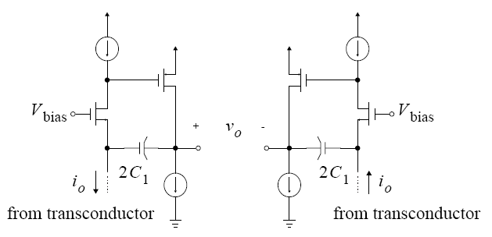
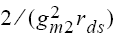
A Simple Gm-C Opamp Integrator
Pseudo-differential operation. Simple opamp:
Opamp has a low input impedance, d, due to common-gate input impedance and feedback.

Slide 62
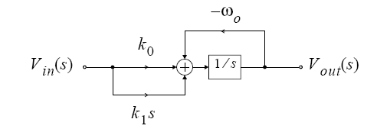
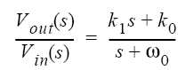
First-Order Gm-C Filter
General first-order transfer-function
Built with a single integrator and two feed-in branches.
Branch ω0 sets the pole frequency.

Slide 63
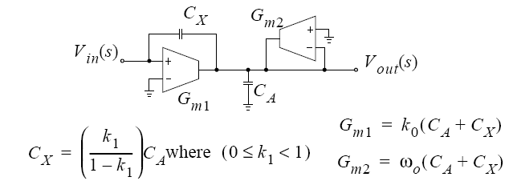
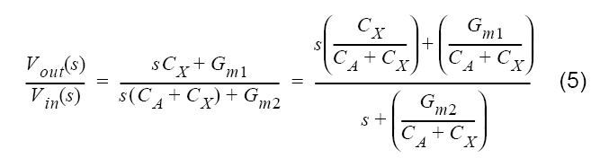
First-Order Filter
At infinite frequency, the voltage gain is Cx/CA. Four parameters, three constraints: impedance scaling possible. The transfer function is given by

Slide 64
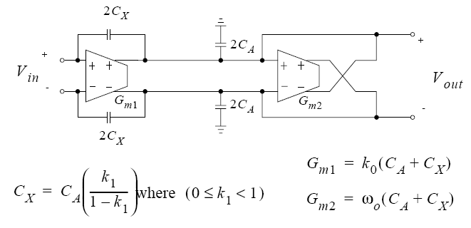
Fully-Differential First-Order Filter
Same equations as for the single-ended case, but the capacitor sizes are doubled.
3 coefficients, 4 parameters. May make Gm1 = Gm2.
Can also realize K1 < 0 by cross-coupling wires at Cx.

Slide 65
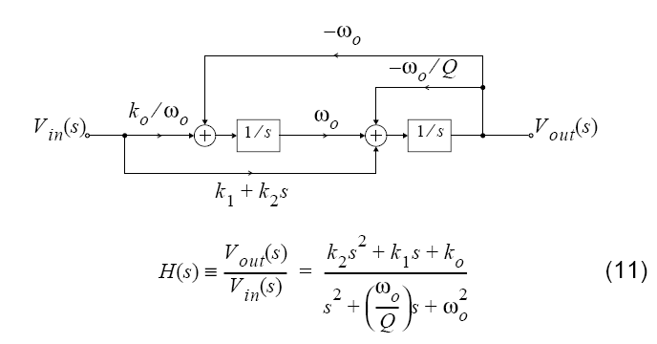
Second-Order Filter
Tow-Thomas biquad:

Slide 66
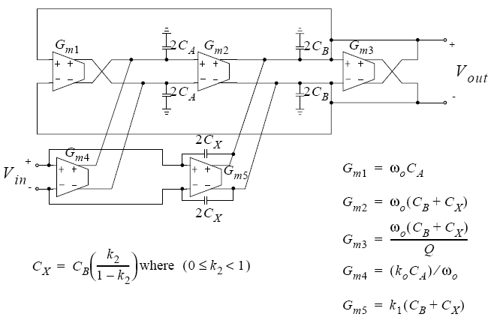
Second-Order Filter
Fully differential realization:

Slide 67
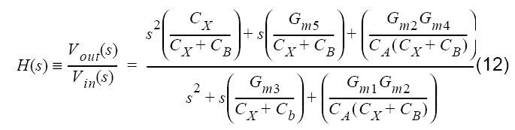
Second-Order Filter
Transfer function:
There is a restriction on the high-frequency gain coefficients k2, just as in the first-order case (not for differential realization).
Gm3 sets the damping of the biquad.
Gm1 and Gm2 form two integrators, with unity-gain frequencies of ω0/s.

Slide 68
Second-Order Filter
5 coefficients needed to match in H(s), 8 designable parameters (5 Gms, 3 capacitances).
Extra degrees of freedom may be used for dynamic range at internal node and impedance scaling, and for using matched Gm blocks.
In cascade design, the input admittance Yin is important. If Cx = 0, Yin = 0. Otherwise, it is Yin = sCx [ 1 – H(s)] .
Yin may be absorbed in the previous stage’s output capacitor CB.

Slide 69
Scaling of Cascade Gm-C Filter
In a cascade of biquads, H(s) = H1(s).H2(s). …. Before realization, scale all Hi(s) so that the maximum output swings are the largest allowable. This takes care of the output swings of Gm2, Gm3, and Gm5.
Multiply Gm1 and Gm4, or divide CA, by the desired voltage scale factor for the internal capacitor CA. This takes care of the output swings of Gm1 and GM4.
It is possible to multiply the Gms and capacitors of both integrators by any constant, to scale the impedances of the circuit at a convenient level (noise vs. chip area and power).

Slide 70
Tuning of MOSFET-C or Gm-C Filters
The control voltage V_{c} is adjusted so that the average input current of the integrator becomes zero. Then, C_{s}/T equals 1/R(V_{c}) or G_{m}(V_{c}), so that the time constant R(V_{c})C_{s} or C_{s}/G_{m} equals the clock period T.
Matching the filter capacitors and its MOSFET or G_{m} elements to the calibration ones, ~1% accuracy can be achieved.

Slide 71
Switched-Capacitor Circuits
History
"SC" replacing "R"; 1873, James Clerk Maxwell, "A TREATISE ON ELECTRICITY AND MAGNETISM", PP. 420-421.
IC Context: 1972, D. L. Fried. Low-, high- and bandpass (n-path!) SC filters.
Application as ADCs: 1975, McCreary and Gray.
1977, UC Berkeley, BNR, AMI, U. of Toronto, Bell labs., UCLA, etc.: Design of high-quality SC filters and other analog blocks.

Slide 72
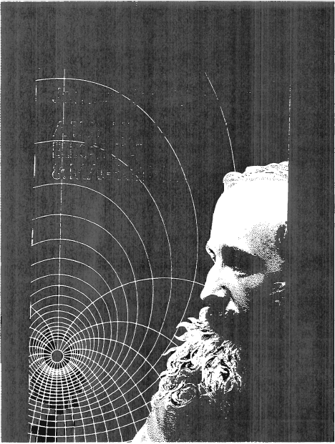
The First Inventor

Slide 73

The Invention

Slide 74
Switched-Capacitor Circuit Techniques [2], [3]
Signal entered and read out as voltages, but processed internally as charges on capacitors. Since CMOS reserves charges well, high SNR and linearity possible.
Replaces absolute accuracy of R & C (10-30%) with matching accuracy of C (0.05-0.2%);
Can realize accurate and tunable large RC time constants;
Can realize high-order dynamic range circuits with high dynamic range;
Allows medium-accuracy data conversion without trimming;
Can realize large mixed-mode systems for telephony, audio, aerospace, physics etc. Applications on a single CMOS chip.
Tilted the MOS VS. BJT contest decisively.

Slide 75
Competing Techniques
Switched-current circuitry: Can be simpler and faster, but achieves lower dynamic range & much more THD; Needs more power. Can use basic digital technology; now SC can too!
Continuous-time filters: much faster, less linear, less accurate, lower dynamic range. Need tuning.

Slide 76

LCR Filters to Active-RC Filters

Slide 77
LCR Filters to Active-SC Filters

Slide 78
Typical Applications of SC Technology –(1)
Line-Powered Systems:
Telecom systems (telephone, radio, video, audio)
Digital/analog interfaces
Smart sensors
Instrumentation
Neural nets.
Music synthesizers

Slide 79
Typical Applications of SC Technology –(2)
Battery-Powered Micropower Systems:
Watches
Calculators
Hearing aids
Pagers
Implantable medical devices
Portable instruments, sensors
Nuclear array sensors (micropower, may not be battery powered)

Slide 80
New SC Circuit Techniques
To improve accuracy:
Oversampling, noise shaping
Dynamic matching
Digital correction
Self-calibration
Offset/gain compensation
To improve speed, selectivity:
GaAs technology
BiCMOS technology
N-path, multirate circuits

Slide 81
Typical SC Stages
Amplifiers: programmable, precision, AGC, buffer, driver, sense
Filters
S/H and T/H stages
MUX and deMUX stages
PLLs
VCOs
Modulators, demodulators
Precision comparators
Attenuators
ADC/DAC blocks

Slide 82
Active - RC Integrator
Can be transformed by replacing R1 by an SC branch.

Slide 83

SC Integrator (Analog Accumulator)
Stray insensitive integrators:
For inverting operation,
H(z) = V_{out}(z)/V_{in}(z) = - (C₁/ C₂)/(1 – z⁻¹)
For noninverting operation
H(z) = (C₁/ C₂) z^{-1/2} / (1 – z⁻¹)

Slide 84
SC Integrator Issues
Every node is an opamp input or output node – low impedance, insensitive to stray capacitances.
Clock phases must be non-overlapping to preserve signal charges. Gap shouldn’t be too large for good SNR.
For single-ended stage, positive = delaying, negative = non-delaying. For differential, polarity is arbitrary.
For cascade design, two integrators can be connected in a Tow-Thomas loop. No inverter stage needed; SC branch can invert charge polarity.

Slide 85

Bilinear SC Stage
Transfer function:
Circuit:

Slide 86
Bilinear SC Stage
Pole and zero both on positive real axis in z plane,
between zero and one.
In differential circuit, cross-coupling can give negative values.
Positive fedeback must be avoided!

Slide 87

Low-Q SC Biquad
Biquadratic transfer function:
SC realization:

Slide 88
Low-Q SC Biquad – (3)
Approximate design equations for ω₀T << 1:
>1,

Slide 89
Low-Q SC Biquad – (4)
Without C4, sine-wave oscillator. With C4, loop phase < 360 degrees for any element values. Poles always inside the unit circle.
DC feedback always negative.
Pole locations determined by C4/CA only - sensitive
to mismatch for high Q!
Capacitance ratio CA/C4 large for high Q.

Slide 90
Low-Q Biquad Issues
Assuming that (as is normally the case) the biquad realizes a pair of complex conjugate poles, the sensitivity to element value variations and other nonideal effects depends largely on the proximity of these poles to the unit circle, i.e. on the value of (1 - |z_{p}|). The smaller this value is, the more selective the response is, and also the more sensitive is the biquad to nonideal effects. The value of (1 - |z_{p}|) can be directly estimated from H(z). For the circuit of Slide 86,
b₀/b₂ = 1/(1+ C₄/C_{B}
1 - |z_{p}| ~ 1/[2(C_{B}/C₄ +1)].
For highly selective filters where 1 - |z_{p}| << 1, this indicates that C_{B}/C₄ must be large, resulting in a large spread of element values, and also that the circuit will be sensitive to errors in C_{B}/C₄. Thus this circuit is not suitable for the realization of such biquadratic H(z) functions.

Slide 91
Low-Q SC Biquad – (4)
For b₀ = 1, matching coefficients:
8 C_{i} values, 5 constraints. Scaling for optimum dynamic
range and impedance level must follow!

Slide 92

High-Q Biquad
For higher pole Q (say Q > 4), high-Q biquad:
1 - b₀/b₂ = C₃C₄/(C_{A}C_{B}), and hence 1 - |z_{p}| ~ C₃C₄/(2C_{A}C_{B}). Hence, even for poles very close to the unit circle, the capacitance ratios need not be very small. Also, an error in C₃ /C_{A} is multiplied by the small factor C₄/C_{B} in H(z), reducing the sensitivity to this error, and vice versa for an error in C₄/C_{B}. This makes the circuit suitable for realizing highly selective transfer functions.

Slide 93

High-Q Biquad – (2)
Approximate design equations :

Slide 94
High-Q Biquad – (3)
Exact equations:
For b₂ = 1, coefficient matching gives C values. Spread & sensitivities reasonable even for high Q & f_{c}/f_{o}, since C₂, C₃, C₄ enter only in products:

Slide 95
Cascade SC Filter Design
Higher-order filter can constructed by cascading low-order ones. The Hi(s) are multiplied, provided the stage outputs are buffered.
The Hi(s) can be obtained from the overall H(s) by factoring the numerator and denominator, and assigning conjugate zeros and poles to each biquad.
Sharp peaks and dips in |H(f)| cause noise spurs in the output. So, dominant poles should be paired with the nearest zeros.
See earlier discussions (Slides 28 – 30) on ordering the stages.

Slide 96

Cascade Design – (2)
Easy to design, layout, test, debug, Passband sensitivities “moderate,” 0.1 - 0.3 dB/% in passband. Stopband sensitivities good. Pairing of num. & denom., ordering of sections all affect S/N, element spread and sensitivities.

Slide 97

SC Ladder Filters
For optimum passband matching, for nominal ∂V_{o}/∂x ~ 0 since V_{o} is maximum x values. x: any L or C.
Use doubly-terminated LCR filter prototype, with 0 flat passband loss.
State equations:

Slide 98

The Exact Design of SC Ladder Filters
Purpose: H_{a}(s_{a}) ↔ H(z), where
Then, gain response is only frequency warped.
Example:
State equations for V₁,I₁ &V₃;
Purpose of splitting C₁:
has a simple z-domain realization.

Slide 99
S_{a}-Domain Block Diagram
Realization of input branch: Q_{in}=V_{in}/s_{a}R_{s}, which becomes,
This relation can be rewritten in the form
or, in the time domain
Δq_{in}(t_{n}) : incremental charge flow during t_{n-1} < t < t_{n}, in SCF.

Slide 100
SC Filter Circuit

Slide 101
Sixth-Order SCBandpass Filter
Sixth-order bandpass filter: LCR prototype and SC realization.
Using bandpass realization tables to obtain low-pass response gives an extra op-amp, which can be eliminated:

Slide 102
Scaling for Optimal DR and Chip Area –(1)
To modify V_{o} → kV_{o} ; Y_{i}/Y_{f} → kY_{i}/Y_{f} ∀i. Hence, change Y_{f} to Y_{f} /k or Y_{i} to kY_{i}. (It doesn't matter which; area scaling makes the results the same.) To keep all output currents unchanged, also Y_{a} → Y_{a}/k, etc.
Noise gain :

Slide 103
Scaling for Optimal DR and Chip Area –(2)
Hence, . The output noise currents are also divided
by k, due to Y′_{a} = Y_{a}/k, etc. Hence, the overall output noise from this stage changes by a factor
where : the signal gain.

Slide 104
Scaling for Optimal DR and Chip Area –(3)
The output signal does not change, so the SNR improves with increasing k. However, the noise reduction is slower than 1/k, and also this noise is only one of the terms in the output noise power.
If V_{o}> V_{DD}, distortion occurs, hence k ≤ k_{max} is limited such that Y_{o} saturates for the same V_{in} as the overall V_{out}. Any k > k_{max} forces the input signal to be reduced by k so the SNR will now decrease with k.
Conclusion: k_{max} is optimum, if settling time is not an issue.

Slide 105
Scaling of SCF's. – (1)
Purposes :
1. Maximum dynamic range
2. Minimum C_{max} / C_{min} , ∑C / C_{min}
3. Minimum sens. to op-amp dc gain
effects.
Assume that opamps have same input noise v²_{n}, and max. linear range |V_{max}|. For an optimum dynamic range V_{in max} / V_{in min}, each opamp should have the same V_{imax}(f), so they all saturate at the same V_{in max}. Otherwise, the S/N of the op-amp is not optimal. May also use histograms!
1. Dynamic range scaling:

Slide 106
Scaling of SCF's. – (2)
To achieve V_{1 max} = V_{2 max} = ••• = V_{out max}, use amplitude scaling:

Slide 107
Scaling of SCF's. – (3)
Simple rule:
Multiply all C_{j} connected or switched to the output of opamp i by k_{i}!

Slide 108
Scaling of SCF's. – (4)
2. Minimum C_{max}/C_{min:}
If all f_{n}(z) & h(z) are multiplied by the same l_{i}, nothing will change. Choose l_{i} = C_{min} / C_{i min} where C_{i min} is the smallest C connected to the input of op-amp i, and C_{min} is the smallest value of cap. permitted by the technology (usually 0.1 pF ≤ C_{min} ≤ 0.5 pF for stray-insensitive circuits). Multiply all caps connected or switched to opamp input by l_{i} . Big effect on C_{max} / C_{min}!
3. Sensitivities:
The sensitivity of the gain to C_{k} remain unchanged by scaling; However, the sensitivity to finite op-amp gain effects is very much reduced. Optimum dynamic-range scaling is nearly optimal for dc gain sens. as well.

Slide 109
Scaling of SCF's. – (5)

Slide 110
Scaling of SCF's. – (6)
GAIN / dB
FREQUENCY / Hz

Slide 111
Scaling of SCF's. – (7)
GAIN / dB
FREQUENCY / Hz

Slide 112
Scaling of SCF's. – (8)
GAIN / dB
FREQUENCY / Hz

Slide 113
SC Filters in Mixed-Mode System
Two situations; example:
Situation 1: Only the sampled values of the output waveform matter; the output spectrum may be limited by the DSP, and hence V_{RMS,n} reduced.
Situation 2: The complete output waveform affects the SNR, including the S/H and direct noise components. Usually the S/H dominates. Reduced by the reconstruction filter.

Slide 114
Direct-Charge-Transfer Stage – (1)
Advantages:
Opamp does not participate in charge transfer → no slewing distortion, clean S/H output waveform. Finite DC gain A, introduces only a scale
factor K = 1/[1+1/A_{o}].

Slide 115
Direct-Charge-Transfer Stage – (2)
Analysis gives
where
is the ideal lowpass filter response.
Applications:
SC-to-CT buffer in smoothing filter for D-S DAC (Sooch et al., AES Conv., Oct. 1991)
DAC + FIR filter + IIR filter (Fujimori et al., JSSC, Aug. 2000).

Slide 116

Double Sampled Data Converter – (1)

Slide 117

Reconstruction Filter Architectures

Slide 118


Post-Filter Examples (1)
A 4th-order Bessel filter implemented with a cascade of biquads
Noise gains from each op-amp input

Slide 119


Post-Filter Examples (2)
A 4th-order Bessel filter implemented with the inverse follow-the-leader topology
Noise gains from each op-amp input

Slide 120
References
[1] R. Schaumann et al., Design of Analog Filters (2nd edition), Oxford University Press, 2010.
[2] D. A. Johns and K. Martin, Analog Integrated Circuits, Wiley, 1997. 2nd ed., 2012.
[3] R. Gregorian and G. C. Temes, Analog MOS Integrated Circuits for Signal Processing, Wiley, 1986.
[4] Introduction to Circuit Synthesis and Design, G. C. Temes and J. W. LaPatra, McGraw-Hill, 1977.
[5] John Khoury, Integrated Continuous-Time Filters, Unpublished Lecture Notes, EPFL, 1998.
[6] P. Kurahashi et al., “A 0.6-V Highly Linear Switched-R-MOSFET-C Filter, CICC, Sept. 2006, pp. 833-836.

Slide 121
Nonidealities in SC Circuits
Switches:
Nonzero “on”-resistance
Clock feedthrough / charge injection
Junction leakage, capacitance
Noise
Capacitors:
Capacitance errors
Voltage and temperature dependence
Random variations
Leakage
Op-amps:
DC offset voltage
Finite dc gain
Finite bandwidth
Nonzero output impedance
Noise

Slide 122

Switched-Capacitor Integrator

Slide 123


Nonzero Switch “On”-Resistance
C is charged exponentially. Time constant must be sufficiently low.
Body effect must be included!
To lower on-resistance and clock feedthrough: CMOS gate; Wp,Lp =Wn,Ln. For settling to within 0.1%, T_{settling} > 7R_{on}C (worst-case R_{on}).

Slide 124

Digital CMOS Scaling Roadmap

Slide 125

Floating Switch Problem in Low-Voltage

Slide 126

Using Low-Threshold Transistors
Precise control over process and temperature difficult
Switch leakage worsens as threshold voltage is lowered (i.e. hard to turn off)

Slide 127

Using Clock Voltage Booster
Boosted clock voltage (e.g. 0 → 2Vdd) is used to sufficiently overdrive the NMOS floating switch – useful in systems with low external power supply voltage and fabricated in high-voltage CMOS process
→ Voltage limitation is violated in low-voltage CMOS

Slide 128

Floating Switch Driver
Replacing Vdd by Vin, circuit:
Q. Fan, Huijsing and K. Makinwa, “A capacitively coupled …”, Digest ISSCC 2012, pp. 374-375.
Timing diagram:

Slide 129

Application to Chopper
All NMOS chopper:
Q. Fan, Huijsing and K. Makinwa, “A capacitively coupled …”, Digest ISSCC 2012, pp. 374-375

Slide 130

Chopper Switch Driver
Using the cross-coupled switch drivers:
Q. Fan, Huijsing and K. Makinwa, “A capacitively coupled …”, Digest ISSCC 2012, pp. 374-375

Slide 131

Using Boostrapped Clock
Principle: pre-sample Vdd before placing it across Vgs (various low-voltage issues complicate implementation)
Input sampling such as this can be used for low-voltage CMOS or for high-linearity sampling
No fundamental or topological limitation on higher input signal frequency w.r.t. sampling frequency

Slide 132

Switched-Opamp Technique
Floating switch is eliminated
Opamp output tri-stated and pulled to ground during reset ϕ₂
→ Slow transient response as opamp is turned back on during ϕ₁

Slide 133

Switched-Opamp Example
Crols et al., JSSC-1994
Peluso et al., JSSC-1997
The entire opamp is turned off during ϕ_{2 .}
Demonstrated 1.5-V operation (ΔΣ)with Vtn=|Vtp|=0.9V.
115kHz at -60dB THD & 500kHz at -72dB THD.

Slide 134

Opamp-Reset = Unity-Gain Configuration

Slide 135

Floating Reference Avoids Fwd Bias
C3 is precharged during ϕ₁
C3 (floating reference) in feedback during ϕ₂
DC offset circuit (C4=C1/2) compensates for Vdd reset of C1
→ effective virtual ground = Vdd/2
Notes:
135

Slide 136

Switched-RC = Resistor Isolation

Slide 137

Switched-RC = Resistor Isolation
Ahn et al., ISSCC-2005 Paper 9.1

Slide 138

Charge Injection (1)
Simple SC integrator

Slide 139



Charge Injection (1) (Cont’d)
The lateral field is v/L , the drift velocity is μv/L. Therefore, the current is
The on-resistance is
and hence
holds.

Slide 140



Charge Injection (2)
From device physics,
Unless S1 is in a well, connected to its source, Vtn depends on Vin, so qch is a mildly nonlinear function of Vin.
When S1 cuts off, part of qch(qs) enters C1 and introduces noise, nonlinearily, gain and offset error.
To reduce qs, choose L small, but and Ron large. However, for 0.1% settling
Hence
and
where

Slide 141


Clock Feedthrough
Capacitive coupling of clock signal via overlap Cov between gate and source. The resulting charge error is
It adds to qs . Usually,
Linear error .
Same for S₁ and S_{2.}

Slide 142

Methods for Reducing Charge Injection
Transmission gates: cancellation if areas are matched. Poor for floating switches, somewhat better for fixed-voltage operation.
Dummy devices: better for d~0.5.

Slide 143

Advanced-Cutoff Switches
Signal-dependent charge injection leads to nonlinear distortions; signal-independent one to fixed offset. Advanced-cutoff switches can reduce signal dependence.

Slide 144


Advanced-Cutoff Switches (Cont’d)
Remaining charge injection is mostly common-mode in a differential stage.
Suppressed by CMRR. In a single-ended circuit, it can be approximated by dummy branch:

Slide 145

Floating Clock Generator
To reduce signal dependence, reference the clock signal to vin:
This makes Ron also signal independent, so the settling is more linear. Clock feedthrough remains signal dependent, but it is a linear effect anyway. Better phasing : precharge Cb to VDD during phase 2, connect to vin during phase 2.

Slide 146

Charge Injection in a Comparator
Remains valid if input phases are interchanged.

Slide 147

Delta-Sigma ADC

Slide 148

Junction Leakage
I ~10 pA/mil² , 0.4pA/5μ x 5μ but doubles for each 10°C.
fmin ~ 100Hz at 20°C, but 25KHz at 100° C.
Fully differential circuit and Martin compensation converts it to common-mode effect.

Slide 149

Capacitances Inaccuracies
Depends only on C ratios. Strays are often p-n junctions, leading to harmonic distortion also. For stray-sensitive integrator, all strays should be < 0.1% of αC.
ΔC can be systematic or random. Random effects (granularity, edge effects, etc.) cannot be compensated, but systematic ones can, by unit-capacitor/common-centroid construction of αC and C.

Slide 150


Capacitances Inaccuracies (Cont’d)
Oxide gradient
Common-centroid geometry
Compensated C1/C2 against linear variations of Cox, and edge related systematic errors (undercut, fringing)

Slide 151


Capacitances Inaccuracies (Cont’d)
Voltage and temperature coefficients
Smaller for ratios, especially for common-centroid layout:
Fringing, undercut: systematic edge effects. Reduced by commoncentroid geometry, since perimeter/area ratio is the same for C1 and C2, .

Slide 152

OPAMP Input Offset
In most analog IC, the active element is the opamp. It is used to create a virtual ground (or virtual short circuit) at its input terminals:
This makes lossless charge transfer possible. In fact, in a CMOS IC, i≈0 but v≠0 due to offset, 1/f and thermal noise and finite opamp gain A. Typically, |v|=5-10mV. This affects both the dc levels and the signal processing properties. The effect of v is even more significant in a low-voltage technology where the signal swing is reduced, and A may be low since cascoding may not be available.

Slide 153
Improving the Virtual Ground
Autozeroing or Correlated Double Sampling Schemes:
Scheme A: Stores and subtracts v at the input or output of the opamp;
Scheme B: Refers all charge redistributions to a (constant) v instead of ground;
Scheme C: Predicts and subtracts v, or references charge manipulations to a predicted.
Compensation using extra input: An added feedback loop generates an extra input to force the output to a reset value for zero input signal.
Chopper stabilization: The signal is modulated to a “safe” (low-noise) frequency range, and demodulated after processing.
Mixed-mode schemes: Establish a known analog input, use digital output for correction.

Slide 154
Circuits Using Autozeroing
Comparators
Amplifiers
S/H, T/H, delay stages
Data converters
Integrators
Filters
Equalizers

Slide 155



Simple Autozeroed Comparator
Nonidealities represented by added noise voltage:
Input-referred noise at the end of interval:
Transfer function without folding:
Vos, V1/f and (for oversampled signals) µVout may be reduced by HN. Here, µVout is not considered, since it is not important for a comparator.

Slide 156

An Offset- and Finite-Gain-Compensated SC Amplifier

Slide 157


Analysis of Compensated Gain Amplifier
Input-output relation for inverting operation:
The S/H capacitor switches from 0 to
Error in H(1): denom. should have + 1. Clock feedthrough generates some residual offset. Can be used as a compensated delay stage.

Slide 158

Finite Opamp DC Gain Effect
Equations valid only for high frequencies.
At unity-gain freq.
Usually, the magnitude error is smaller the (C1/C2) error and is negligible. The phase error shifts poles/zeros horizontally, like dissipation: important!

Slide 159

Finite Opamp DC Gain Effect (Cont’d)

Slide 160





Model for Finite Opamp Gain Effect
is the charge flow in one clock period

Slide 161



Model for Finite Opamp Gain Effect
For finite A_{O},
so the model is

Slide 162

Finite Opamp Bandwidth Effect

Slide 163

Finite Opamp Bandwidth Effect (Cont’d)
For k < 1, even higher ωo may be needed. Due to the exponential behavior, the error increases rapidly if ω0 is too small!
The derivation assumes vin(t) is constant. If several stages settle simultaneously, or if there is a continuous-time loop of opamp and coupling C’s, then computer analysis (SWITCAP, Fang/Tsividis) is needed.

Slide 164










Time Constant of OTA-SC Integrator
At pole S_{P}, V₁=V⁻
Open-loop Gain
Transient term:
Unity-gain conventional integrator, assuming all C is equal:

Slide 165


Integrator Using a Two-Stage (Buffered) Opamp
Let Initial Values be V_{C1}=V₁, V_{C2}=0

Slide 166






Integrator Using a Two-Stage (Buffered) Opamp
Pole at:
Time Constant:
Settling level:

Slide 167

High-Q Biquad
For original phases, both opamps settle when Ф2→1. Changing the switches of C3, they settle separately. V1 changes twice in one cycles, but OA1 still has the same T/2 time (T for the change at Ф1→1.) to settle and to charge C3. The transient when Ф2→1 has a full period to settle in OA1 and OA2 .

Slide 168



Slew Rate Estimation (1)
Nonlinear slewing followed by linear settling:

Slide 169
Slew Rate Estimation (2)
Much simpler estimate can be based on assuming that Cin is fully discharged in the slewing phase. Then the slew current can be found from
Is ~ Cin.Vin,max/[x.T/2]
Less pessimistic than the previous estimate.

Slide 170


Noise Considerations
Clock feedthrough from switches
External noise coupled in from substrate, power lines, etc
Thermal and 1/f noise generated in switches and opamps
(1) Has components at f=0, fc, can be reduced by dummy switches,
differential circuit, etc. May be signal dependent!
(2) Discussed elsewhere.
(3) Thermal noise in MOSFETs: PSD is
For f≥0, only (one-sided distribution).
Flicker noise:
Total noise PSD: S=ST+Sf .

Slide 171



Noise Considerations (Cont’d)
Noise spectra
Offset compensation (CDS—correlated double sampling); subtracts noise, T/2 second delayed.
CDS:
1. Pick up noise, no signal;
2. Pick up noise, plus signal;
3. Substract the two.

Slide 172

Chopper Stabilization
Fully differential circuits needed.

Slide 173

Chopper Stabilization (Cont’d)
Differential SC amplifier using chopping.

Slide 174



Noise Aliasing
Mean-square values are the same (θ /C )
within all windows.
Direct noise power:
S/H PSD:
S(f): RC filtered direct noise
Most noise at dc!

Slide 175



Equivalent Circuit for Direct Noise
S(f) for direct noise: low-pass filtered and windowed white noise.
For satisfactory settling (0.1%),

Slide 176



Noise Aliasing
Aliasing for

Slide 177

Noise Spectra
For m=0.25, r=31.5!
Noise generated in stage independent of Ron, but the noise generated in preceding stages (direct noise) gets filtered, so the Ron should be as large as possible!

Slide 178

Switched-Capacitor Noise
Two situations; example:
Situation 1: only the sampled values of the output waveform matter; the output spectrum may be limited by the DSP, and hence V_{RMS,n} reduced. Find V_{RMS} from √KTC charges; adjust for DSP effects.
Situation 2: the complete output waveform affects the SNR, including the S/H and direct noise components. Usually the S/H dominates. Reduced by the reconstruction filter.

Slide 179
Calculation of SC Noise (Summary)
In the switch-capacitor branch, when the switch is on, the capacitor charge noise is lowpass-filtered by Ron and C. The resulting charge noise power in C is kTC. It is a colored noise, with a noisebandwidth fn=1/(4RonC). The low-frequency PSD is 4kTRon.
When the switch operates at a rate fc<<fn, the samples of the charge noise still have the same power kTC, but spectrum is now white, with a PSD=2kTC/fc. For the situation when only discrete samples of the signal and noise are used, this is all that we need to know.
For continuous-time analysis, we need to find the powers and spectra of the direct and S/H components when the switch is active. The direct noise is obtained by windowing the filtered charge noise stored in C with a periodic window containing unit pulses of length m/fc. This operation (to a good approximation)
simply scales the PSD, and hence the noise power, by m. The low-frequncy PSD is thus 4mkTRon.

Slide 180

Calculation of SC Noise (Summary) (Cont’d)
To find the PSD of the S/H noise, let the noise charge in C be sampled and- held at fc, and then windowed by a rectangular periodic window
w(t)=0 for n/fc<t<n/fc+m/fc
w(t)=1 for n/fc+m/fc<t<(n+1)/fc
n=0,1,2,…
Note that is windowing reduces the noise power by (1-m) squared(!), since the S/H noise is not random within each period.
Usually, at low frequencies the S/H noise dominates, since it has approximately the same average power as the direct noise, but its PSD spectrum is concentrated at low frequencies. As a first estimate, its PSD can be estimated at for frequencies up to fc/2.

Slide 181
Switched R-MOSFET-C Filters
P. Kurahashi, P. Hanumolu, G. Temes and U. Moon
(JSSC, pp.1699-1709, Aug. 2007)

Slide 182
Switched R-MOSFET-C (SRMC) Filter
R-MOSFET-C
Switched Capacitor
C
C₂
V_{g}
Φ
Φ
+
+
C₁
Switched R-MOSFET-C
C
Φ
+
Adjustable Duty Cycle Control

Slide 183
Switched-MOSFET Equivalent Resistance
C
Φ
R_{on}
Ф
V_{in}
V_{in}
+
I
Φ
Duty Cycle
(as a fraction)
t
I
I_{max} = V_{in} / R_{on}
I_{ave} = I_{max} * d
t
V_{in}
I_{ave} =
(R_{on}/d)
R_{eq}

Slide 184
Switched-MOSFET Equivalent Resistance
R_{on}
Ф
V_{in}
I
R_{eq} = R_{on}/d
R_{on}
d
0
1

Slide 185
Switched R-MOSFET-C Filter
MOSFET is a non-linear element
Linearity can be improved by adding a resistance in series
Voltage mostly dropped across linear resistor
Ф
Ф
R
>>
R_{on}
ΔV_{R}
>>
ΔV_{M1}

Slide 186
Switched R-MOSFET-C Filter
Ф
R
C
Combine switches
Ф
R
V_{in}
V_{out}
R
C
Ф
R
V_{in}
V_{out}

Slide 187
Standard Voltage Operation
V_{in} and V_{out} should be at V_{DD}/2 for maximum signal swing
But V₁ and V₂ should be near ground
for M1 to turn fully on
for the use of a low voltage opamp with PMOS inputs
R
C
Ф
V_{DD}
R
V₁
V₂
V_{DD}
V_{in}
M1
V_{out}
0
0
V_{DD}/2

Slide 188
Low Voltage Opamp
Input common mode is biased toward ground for low-voltage

Slide 189
Low Voltage Operation
V₁ and V₂ can be biased near ground using a resistor R_{B}
(or a current source) [Karthikeyan et al., 2000]
No floating switches and biases opamp but …
Increases opamp noise gain
R
V_{DD}
C
0
V_{DD}
Ф
V₁
V₂
V_{DD}
V_{in}
M1
V_{out}
0
R
R_{B}
0
V_{B} ~ 0

Slide 190
Level-Shifted Low Voltage Operation
V₁ and V₂ can be biased near ground using a current source or resistor (Karthikeyan TCAS2-2000)
Maximizes gate voltage of switches
Biases opamp input (PMOS input pair)
Noise trade-off
Ф
V₁
V₂
V_{in}
V_{out}
M1
or
Ф
M2
V_{x} ~ 0
V_{x} ~ 0

Slide 191
Low Voltage Operation (Differential)
Voltage divider determines opamp input common-mode
or
V_{in}
Φ
Φ
+
V_{out}
+
or

Slide 192
Switching Dynamics
Track and hold operation
Time constant depends on duty cycle
Time constant independent of clock frequency

Slide 193
Corner Frequency Tuning
f_{corner} = f_{continuous} x duty cycle / 100
f_{continuous} = 4MHz
f_{corner}
duty cycle
1MHz
25%
2MHz
50% nominal
3MHz
75%

Slide 194
Signal Modulation Effect
Filter model
Modulation occurs before filtering
V_{in}(t)
V_{out}(t)
Ф(t)
Anti-aliasing filter is needed
|Ф(f)|
Ф(t)
Fourier Transform
f
f_{clk}
2f_{clk}
3f_{clk}
4f_{clk}
5f_{clk}

Slide 195
Signal Modulation Effect
Step 1) Input noise signal modulated by clock
|Vin(f)|
f
f_{clk}
2f_{clk}
3f_{clk}
4f_{clk}
f_{noise}
|Vin(f) Ф(f)|
Modulation and Scaling
f
f_{clk}
2f_{clk}
3f_{clk}
4f_{clk}
f_{clk} - f_{noise}
f_{noise}
f_{clk}+ f_{noise}
3f_{clk} - f_{noise}
3f_{clk} + f_{noise}

Slide 196
Signal Modulation Effect
Step 2) Signal is filtered
|Vout(f)|
f
f_{clk}
2f_{clk}
3f_{clk}
4f_{clk}
f_{clk} - f_{noise}
Anti-aliasing filter is needed

Slide 197
Anti-Aliasing Filter
SRMC permits high clock frequency
No capacitor settling requirements
Relaxed anti-aliasing filter requirements
SRMC
AAF
f
f_{corner}
f_{AAF}
f_{clk} ~ 100-1000 f_{corner}

Slide 198
Resistor Noise
Modulation causes noise aliasing
Continuous vs. SRMC
Noise aliasing causes noise transfer function to double (at 50% duty cycle)
Total noise is equivalent standard RC filter
Noise Transfer Function
2
2
SRMC
p₁
p₁
SRMC
Continuous
Continuous

Slide 199
Opamp Noise
Modulation Causes Noise Aliasing
Opamp noise transfer function is 25% higher in SRMC (at 50% duty cycle)
Noise Transfer Function
2
2
p₁
z₁ = 2 p₁
p₁
z₁ = 2 p₁
SRMC
Continuous

Slide 200
Switch Noise
Modulation causes noise aliasing
Noise aliasing causes noise transfer function to double
Switch not present in continuous case, but this noise adds little (negligible) in SRMC
Noise Transfer Function
Not Normally Present
|TF|
2
|TF|
2
8
4
p₁
f
f
SRMC
Continuous
(switch always on)

Slide 201
Noise Transfer Function
Switch
Noise |TF|² vs. Duty Cycle
16
Switch
14
Opamp
Resistor
12
Opamp
10
8
DC Noise Transfer Function Magnitude
6
4
Resistor
2
0
25
30
35
40
45
50
55
60
65
70
75
Duty Cycle [%]

Slide 202
SRMC Biquad Implementation (Tow-Thomas)
34kΩ
24kΩ
6.8kΩ
22.5pF
4.5kΩ
15pF
34kΩ
22.6kΩ
v_{in}
Φ
Φ
+
Φ
Φ
+
v_{out}
+
+
34kΩ
22.6kΩ
6.8kΩ
22.5pF
4.5kΩ
15pF
24kΩ
34kΩ
f_{-3dB}=135kHz / f_{clock}=128MHz / f_{reference}=2MHz)

Slide 203
References for Tuning
Off-chip Reference
On-chip Tuning Device
R_{ref}
R-MOSFET
Element
Tuning
C_{ref}
MOSCAP
f_{ref}
R-MOSFET-C
Time
Constant
Tuning

Slide 204
Duty Cycle Based Tuning Circuit (Master)
Branch currents will be equal when:
Switched-capacitor path
V_{DD}
Ф_{SC1}
C_{SC}
Ф_{SC1}
reference clock
frequency
Ф_{SC2}
1
C
f_{sc} =
Ф
R_{eq}C_{sc}
R
V_{DD}
+
SRMC branch resistance
SRMC path

Slide 205
Master-Slave Tuning Circuit
error
Duty Cycle
Clock Generator
V_{ref}
Master
Ф
V_{in}
Slave
V_{out}

Slide 206
Differential Time Constant Comparison
Digital Tuning Cell
⇨
SRMC path
Error
Integrator
Loop Filter
Switched-capacitor path

Slide 207
Duty Cycle Clock Generator Detail
Comparator
Voltage
to
Current
Control
Current
Starved
Capacitor
Non Overlapping
Clock Generator
⇨
Reset Pulse Generator

Slide 208

SRMC Filter Prototype IC Layout
Kurahashi et al., CICC-2006 (to appear)
Tuning
Filter
0.5mm
1.4mm
Die Photo
0.18µm CMOS

Slide 209
Measured Filter Response
135kHz cutoff frequency

Slide 210
Measured THD
Input amplitude = 0.6Vpp (differential)

Slide 211
Measured Output Spectrum
Input amplitude = 0.6Vpp (differential)
0.6V Supply
0.8V Supply
77dB
90dB

Slide 212
Measured SNR
Integrated from 1kHz
Referred to 0.6Vpp input

